Slide 1
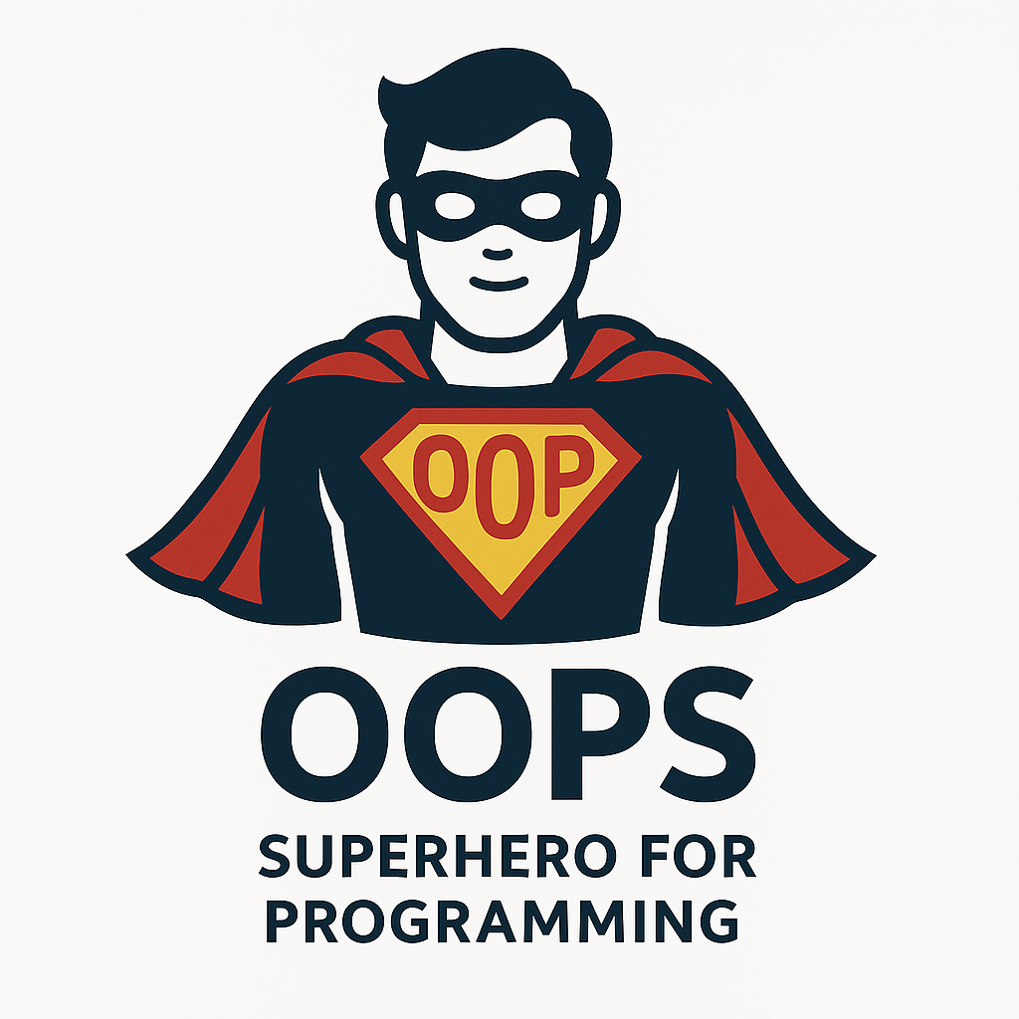
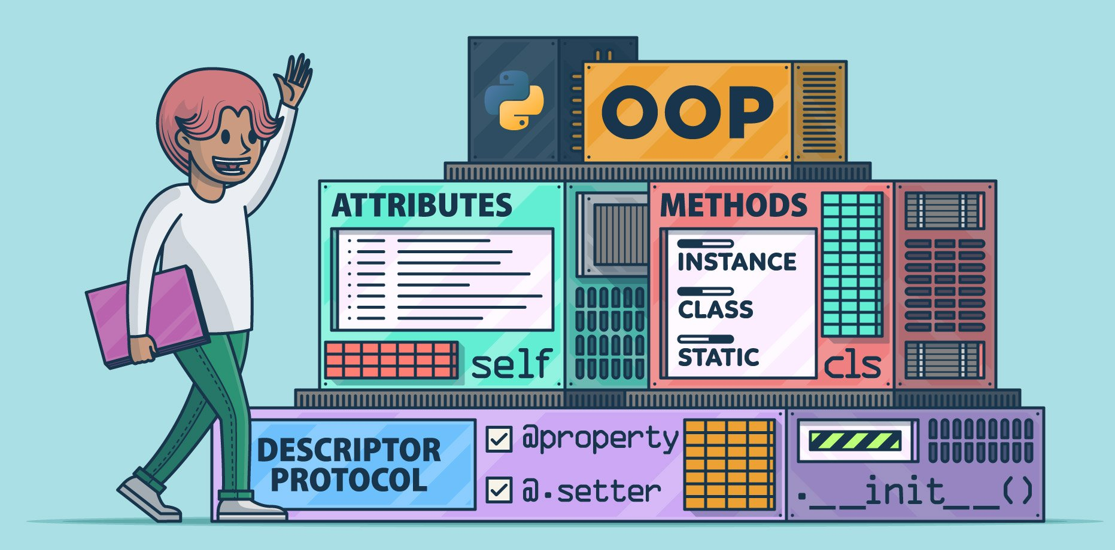
What is OOPs ?
Object-Oriented Programming is a design approach where software is built around the concept of objects, which are instances of classes.
These objects encapsulate data (attributes) and behavior (methods), allowing developers to model real-world entities in code.

Slide 2
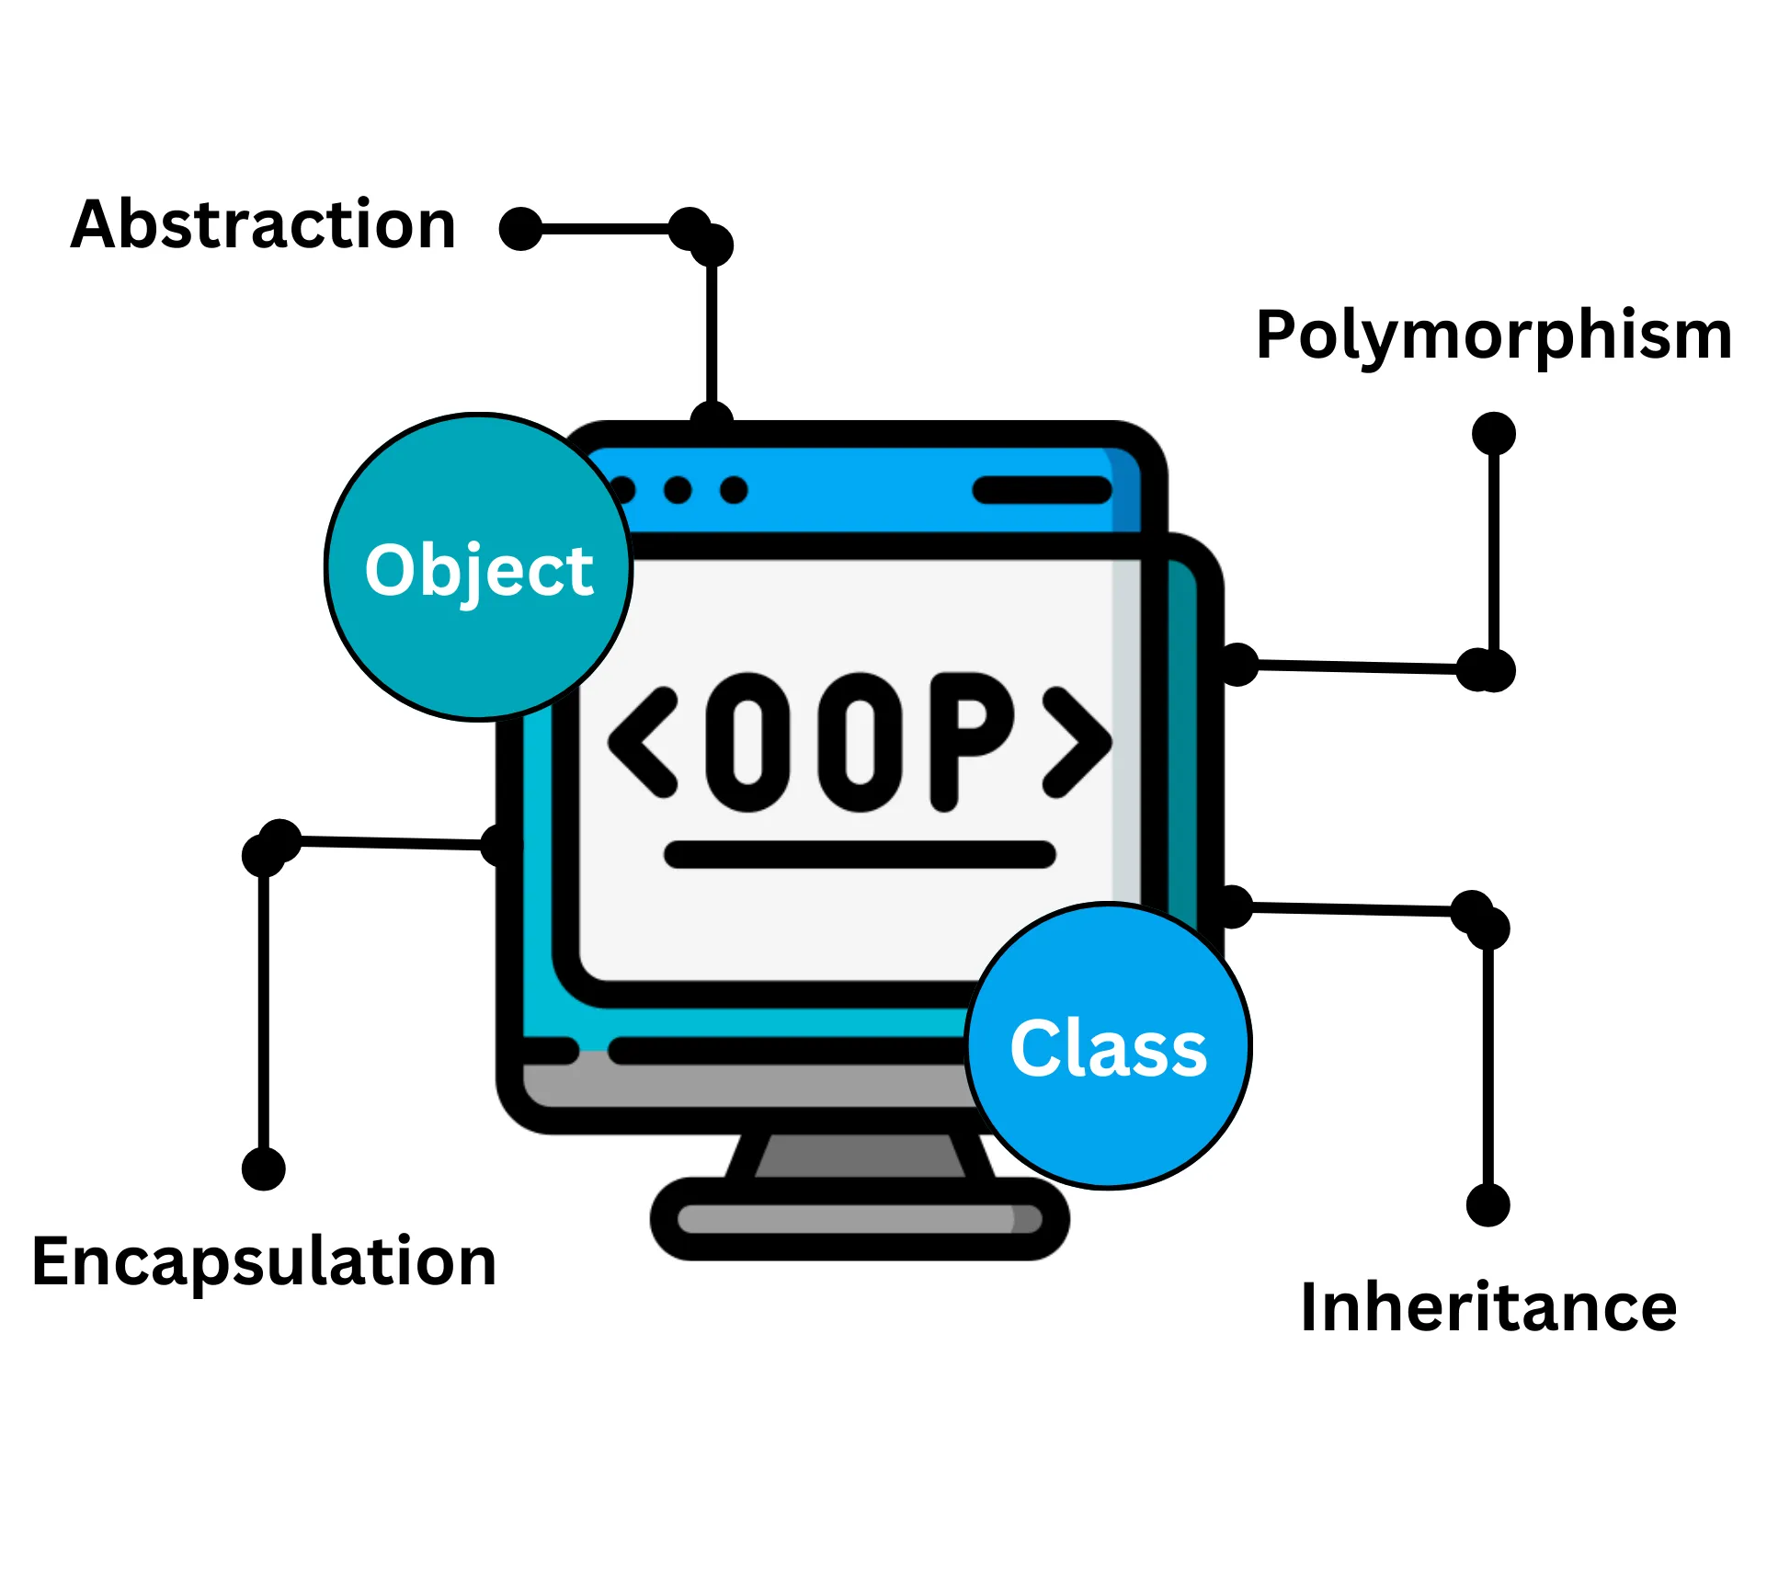
4 Fundamental Pillars of OOPs?

Slide 3
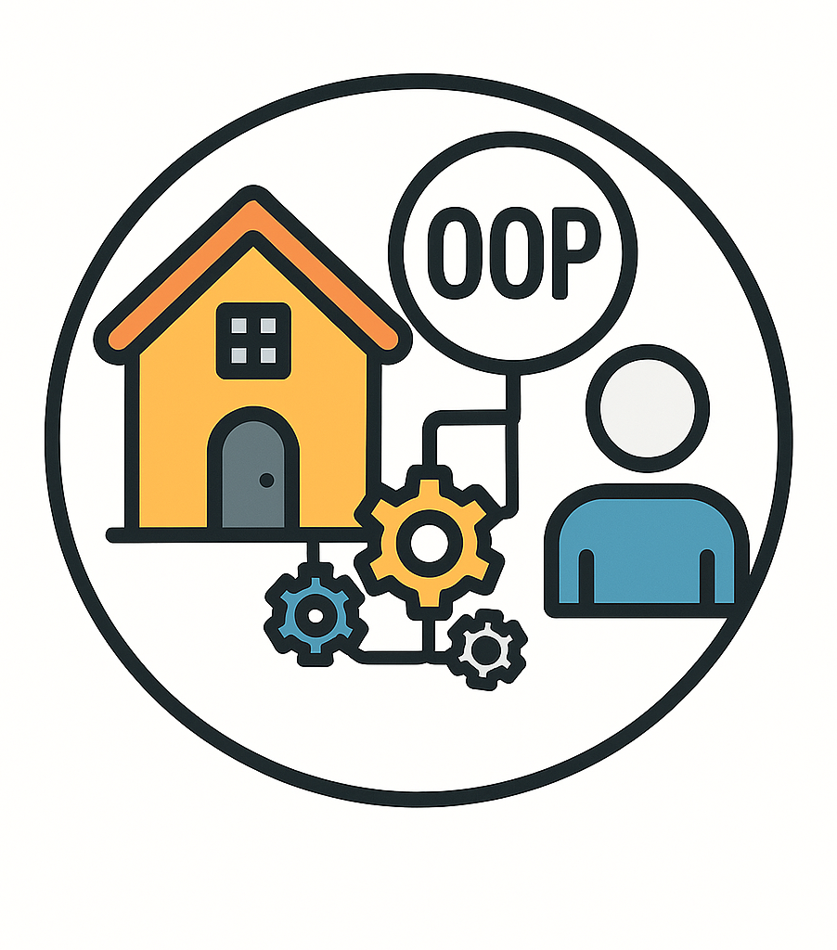
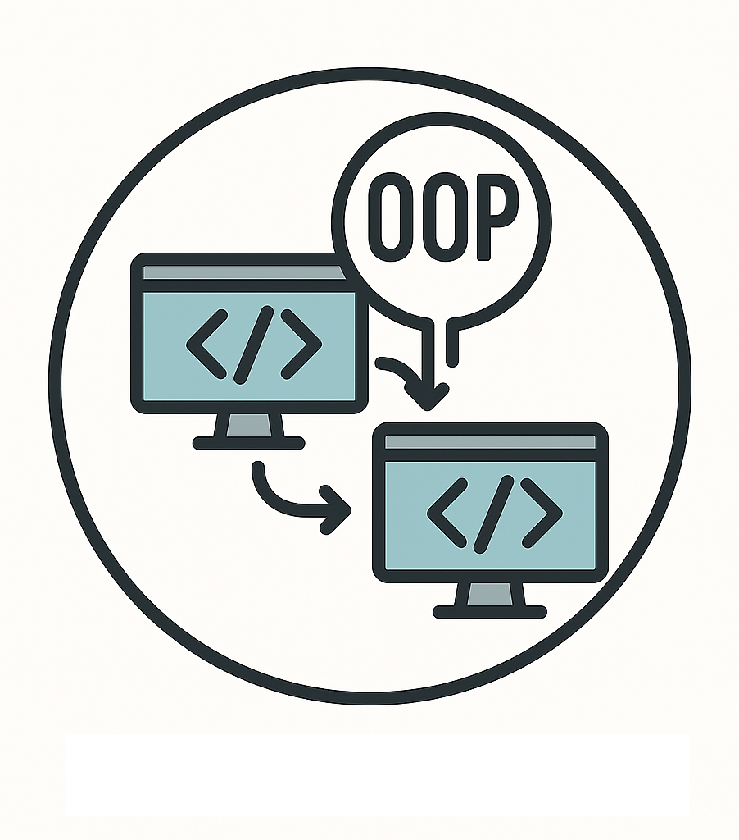
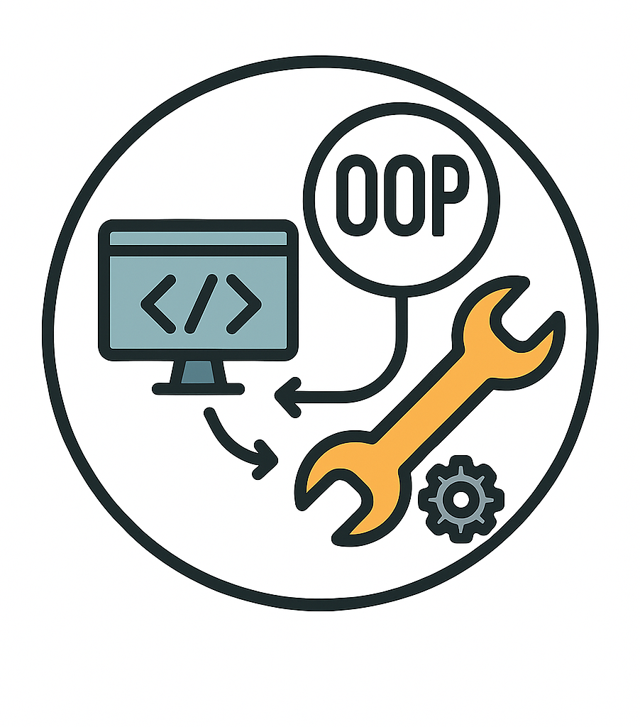

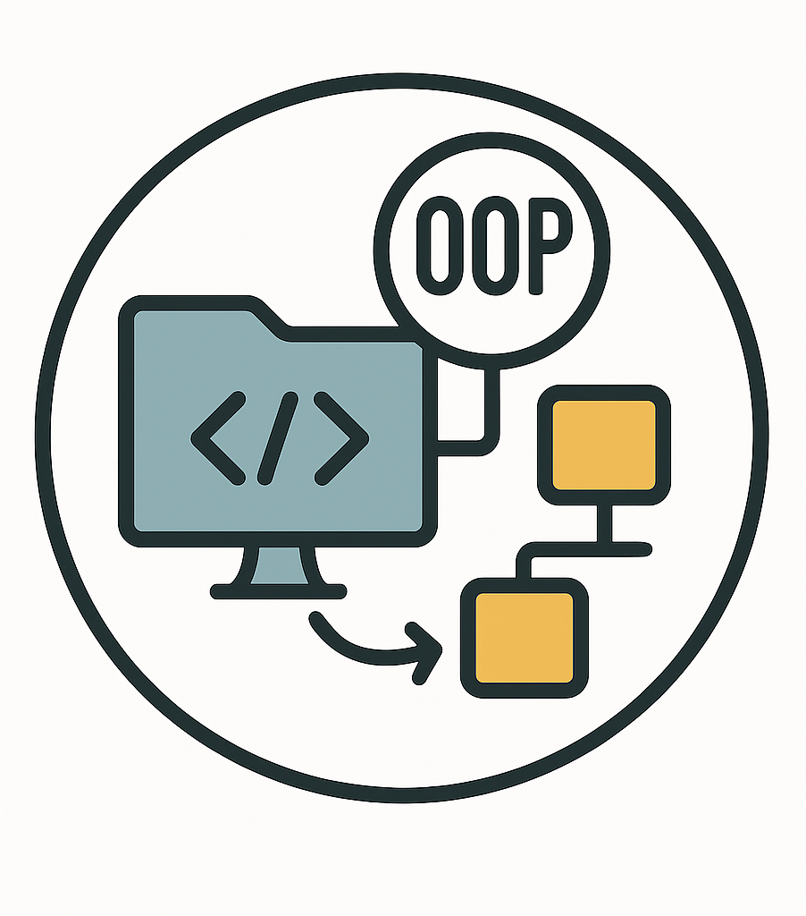
Why OOPs is needed ?
01
02
03
04
05
Real-World Modelling
Code Reusability
Maintainability
Scalability
Extensibility

